Slide 1
System Analysis and Design
Unit 2: Planning

Slide 2
Identification and Selection of System Development Projects
1st phase of the SDLC is planning, consisting of
Project Identification and Selection
Project Initiation and Planning

Slide 3
Project Identification and Selection
During this, a senior manager, a business group, an IS manager, or a steering committee identifies and assesses all possible systems development projects that an organization can take.
Next, those projects which seems to yield significant organizational benefits, are selected for development.
In some large organizations, project identification and selection is a very formal process in which projects are outcomes of a larger overall planning process.
In small organization, they may use informal project selection processes to select projects

Slide 4
The Process of Identifying and Selecting IS Development Projects consists of three primary activities:
Identifying potential development projects
Classifying and ranking IS development projects
Selecting IS development projects

Slide 5
Identifying potential development projects.
Organizations vary as to how they identify projects.
Top Management
Steering Commitee
User Department
Development Group

Slide 6
This process can be performed by
1. a key member of top management, either the CEO of a small- or medium sized organization or a senior executive in a larger organization;
They more often have a strategic organizational focus
2. a steering committee, composed of a cross section of managers with an interest in systems
reflect diversity of the committee and therefore have a cross functional focus.
3. user departments, in which either the head of the requesting unit or a committee from the requesting department decides which projects to submit
often a systems analyst will help users prepare such requests
provide a narrow, tactical focus
4. development group or a senior IS manager
Focuses on existing hardware and systems will integrate with existing project

Slide 7
Each methods of identification have strengths and weaknesses.
Other factors that influence people to select the project are: cost, duration, complexity, and risk.
Project Source | Cost | Duration | Complexity | System Size | Focus
Top Management | Highest | Longest | Highest | Largest | Strategic
Steering Commitee | High | Long | High | Large | Cross Functional
User Department | Low | Short | Low | Small | Departmental
Development Group | Low-High | Short-long | Low-High | Small-large | Integration with existing system

Slide 8
2. Classifying and ranking IS development projects
focuses on assessing the benefit of potential projects.
As with project identification process, classifying and ranking projects can be performed by
top managers,
a steering committee,
business units, or
the IS development group.
The criteria used when assigning the merit of a given project can vary based on the size of organization

Slide 9
Table 2.2: Possible evaluation criteria when classifying and ranking projects
Evaluation Criteria | Description
Value Chain Analysis | Extent to which activities add value and costs when developing products and/or services
Strategic Alignment | Extent to which the project is viewed as helping the organization activities and long-term goals
Potential Benefits | Extent to which the project is viewed as improving profits, customer service,... etc., and the duration of these benefits
Resource Availability | Amount and type of resources the project requires and their availability
Project Size/Duration | Number of individuals and the length of time needed to complete the project
Technical Difficulty/Risks | Level of technical difficulty to successfully complete the project within given time and resource constraints

Slide 10
3. Selecting IS development projects
the actual selection of projects for further development.
Project selection is a process of considering both short and long-term projects and
selecting those most likely to achieve business objectives.
Additionally, as business conditions change over time, the relative importance of any single project may substantially change.
Thus, the identification and selection of projects is a very important and ongoing activity.

Slide 11
Numerous factors must be considered when selecting a project:
Perceived needs of the organization
Existing systems and ongoing projects
Resource availability
Evaluation criteria
Current business conditions
Perspectives of the decision makers

Slide 12
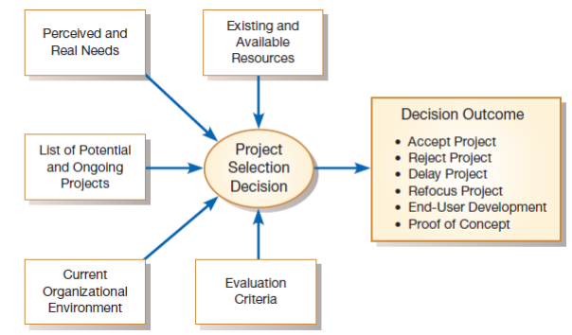
Fig: Project selection decisions must consider numerous factors and can have numerous outcomes

Slide 13
Corporate and Information Systems Planning
Corporate - Relating to large company or group
organizations have not traditionally used a systematic planning process when determining how to allocate IS resources
Many organizations have often isolated themselves to solve organizational problem
organizations have asked the question:
“What procedure (application program) is required to solve this particular problem as it exists today?”
The difficulty with this approach is that the required organizational procedures are likely to change over time as the environment changes.
For example, a company may decide to change its method of billing customers or a university may change its procedure for registering students.
When such changes occur, it is usually necessary to again modify existing information systems.

Slide 14
Problems:
cost of information systems has risen steadily and approaches 40 percent of total expenses in some organizations.
Many systems cannot handle applications that cross organizational boundaries.
Many systems often do not address the critical problems of the business as a whole or support strategic applications.
Data redundancy is often out of control, and users may have little confidence in the quality of data
Systems maintenance costs are out of control as old, poorly planned systems must constantly be revised
Application backlogs (uncompleted work) often extend three years or more, and frustrated end users are forced to create (or purchase) their own systems, often creating redundant databases and incompatible systems in the process

Slide 15
Corporate Strategic Planning
A necessary precondition for making effective project selection decisions is to
gain a clear idea of where an organization is,
its vision of where it wants to be in the future,
and how to make the transition to its desired future state.
Corporate strategic planning is a three-step process:
Step 1
Current Enterprise
Step 2
Future Enterprise
Step 3
Strategic Plan

Slide 16
The first step focuses on gaining an understanding of the current enterprise.
In other words, if you don't know where you are, it is impossible to tell where you are going.
Next, top management must determine where it wants the enterprise to be in the future.
Finally, after gaining an understanding of the current and future enterprise, a strategic plan can be developed to guide this transition.

Slide 17
Corporate strategic planning is an ongoing process that defines the mission, objectives, and strategies of an organization.
During this, executives typically develop a mission statement, statements of future corporate objectives, and strategies designed to help the organization reach its objectives.
mission statement - states what business the company is in.
Objectives - refer to "broad and timeless" goals
- series of statements that express organization's qualitative and quantitative goals for reaching a desired future position.
competitive strategy - a method by which an organization attempts to achieve its mission and objectives.

Slide 18
Generic Competitive Strategies
Strategy | Description
Low-Cost Producer | reflects competing in an industry on the basis of product or service cost to the consumer. Eg, Alibaba
Product Differentiation | reflects capitalizing on a key product criteria requested by the market Eg, high quality products, style, performance
Product Focus or Niche | similar to both the low-cost and differentiation strategies but with a much narrower market focus. Eg, books, shoes, tshirt, tech, laptops, mobiles

Slide 19
Information Systems Planning
2nd planning process playing a significant role in quality of project identification and selection decisions is information systems planning (ISP).
ISP is an
orderly means of assessing the information needs of an organization and
defining the information systems, databases, and technologies that will best satisfy those needs.

Slide 20
Like corporate strategic planning, ISP is a three-step process in which:
1st step is to assess current IS-related assets-human resources, data, processes, and technologies.
Next, target blueprints of these resources are developed.
These blueprints reflect the desired future state of resources needed by the organization to reach it objectives as defined during strategic planning.
Finally, a series of scheduled projects is defined to help move the organization from its current to its future desired state.

Slide 21
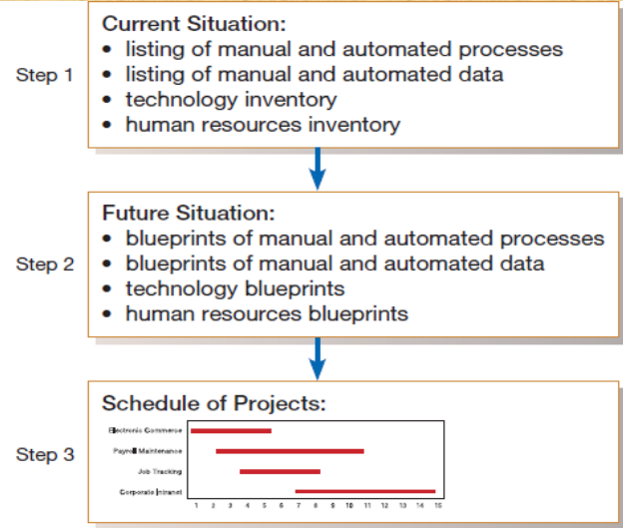
Fig: Information systems planning is a threestep process

Slide 22
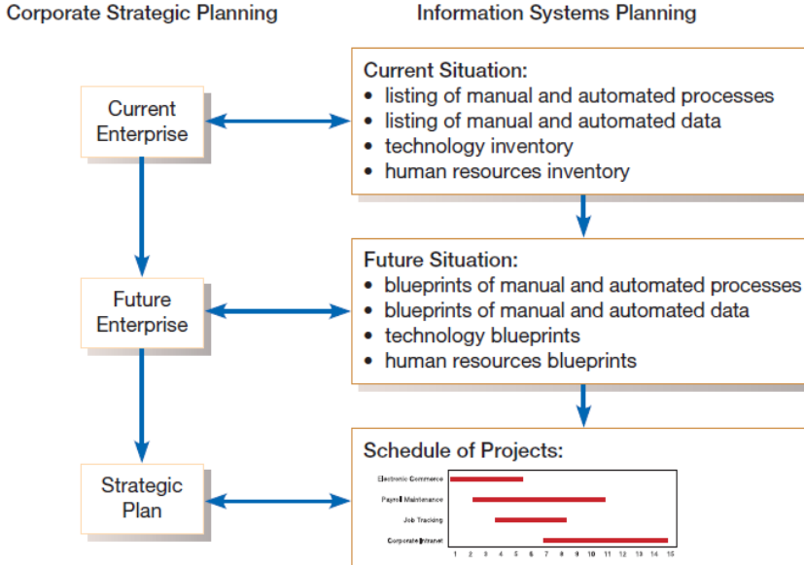
Parallel activities of Corporate Strategic Planning and Information Systems Planning

Slide 23
three activities:
Describe the current situation
referred to as top-down planning.
Top-down planning attempts to gain a broad understanding of the informational needs of the entire organization.
The approach begins by conducting an extensive analysis of the organization’s mission, objectives, and strategy
and determining the information requirements needed to meet each objective.

Slide 24
three activities:
Describe the current situation
referred to as top-down planning.
Top-down planning attempts to gain a broad understanding of the informational needs of the entire organization.
The approach begins by conducting an extensive analysis of the organization’s mission, objectives, and strategy
and determining the information requirements needed to meet each objective.

Slide 25
three activities:
Describe the current situation
referred to as top-down planning.
Top-down planning attempts to gain a broad understanding of the informational needs of the entire organization.
The approach begins by conducting an extensive analysis of the organization’s mission, objectives, and strategy
and determining the information requirements needed to meet each objective.

Slide 26
Advantages
Broader Perspective
Improved Integration
Improved Management Support
Better Understanding

Slide 27
In contrast to the top-down planning approach, a bottom-up planning approach can be also used
It requires the identification of business problems and opportunities that are used to define projects.
Using this, creating IS plans can be faster and less costly than top-down approach;
it also has the advantage of identifying pressing organizational problems.
But disadvantage is that this approach often fails to view the informational needs of the entire organization.
This can result in the creation of different information systems and databases that are redundant or not easily integrated without substantial rework.

Slide 28
2. Describing the target situation, trends, and constraints
Next, define the target situation that reflects the desired future state of the organization.
target situation consists of the desired state of the locations, units, functions, processes, data, and IS
Eg,
if a desired future state of the organization is to have several new branch offices or a new product line
that requires several new employee positions, functions, processes, and data,
then most lists and matrices will need to be updated to reflect this vision.
The target situation must be developed in light of technology and business trends, in addition to organizational constraints.

Slide 29
3. Developing a transition strategy and plans
Now a detailed transition strategy and plan are developed by the IS planning team.
This plan should be very comprehensive, reflecting broad, long-range, short-range planning issues
Also providing sufficient detail to guide all levels of management concerning what needs to be done, how, when, and by whom in the organization.

Slide 30
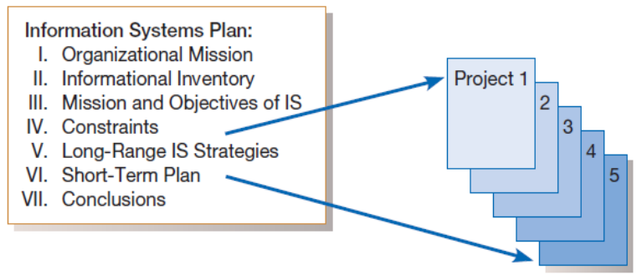
Components of IS Plan

Slide 31
1. Organizational Mission, Objectives, and Strategy:
Briefly describes the mission, objectives, and strategy of the organization.
The current and future views of the company are also briefly presented
2. Informational Inventory:
provides a summary of the various business processes, functions, data entities, and information needs of the enterprise.
This inventory will view both current and future needs.

Slide 32
3. Mission and Objectives of IS:
Description of the primary role IS will play in the organization to transform the enterprise from its current to future state.
represents the current best estimate of the overall role for IS within the organization.
Eg, this role may be as a necessary cost, an investment, or a strategic advantage
4. Constraints on IS Development:
Briefly describes limitations imposed by technology and current level of resources within the company-financial, technological, and personnel.

Slide 33
5. Overall Systems Needs and Long-Range IS Strategies:
Presents a summary of the overall systems needs within the company
and the set of long-range (2-5 years) strategies chosen by the IS department to fill the needs.
6. The Short-Term Plan:
Shows a detailed inventory of present projects and systems and a detailed plan of projects to be developed or advanced during the current year.
These projects may be the result of the long-range IS strategies or of requests from managers that have already been approved and are in some stage of the life cycle.

Slide 34
7. Conclusions:
Contains likely but not-yet certain events that may affect
the plan,
an inventory of business change elements as presently known,
and a description of their estimated impact on the plan

